Slide 1
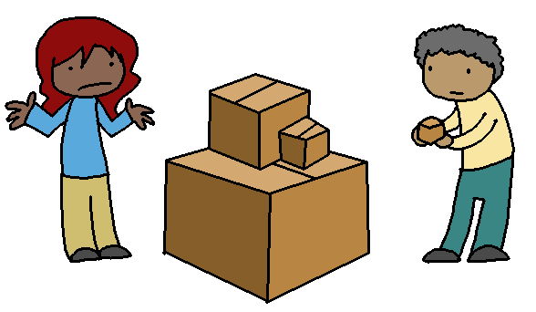
Sprint 1: What to work on
CS/IT 490 WD, Fall 2013

Slide 2
Breakdown
Sprint Information
Concepts covered this sprint
Things to work on

Slide 3
Sprint Information
Sprint 1 ends on 2013-09-10 (Tuesday)
Showcase is due on 2013-09-10 (Tuesday)
Postmortem is due the following Friday, 2013-09-13
Sprint 2 Plan is due the following Monday, 2013-09-16

Slide 4
Concepts covered this sprint
This sprint we should plan on covering:
  HTML Basics
  CSS Basics

Slide 5
Things to work on
Page Mockups
  Once we've covered HTML and CSS, your team should be able to begin working on page mockups.
  These mockups will be modified later with PHP to make the content dynamic.

Slide 6
Things to work on
If you're working on a blog, for example, try to mockup pages like:
Front / Welcome Page
Sign-In Page / Register Page
User Control Panel
  New Post
  Edit Post
Public blog view
Blog archive view for date ####-##-##

Slide 7
Things to work on
Work should be split up, everyone should work on certain pages' HTML and CSS.
  Tommy will work on the User Control Panel / Settings pages
  Lisa will work on the public blog views (single post, all posts, archive for certain dates)
  Denny will work on the Front Page and tutorial pages

Slide 8
Things to work on
Figure out what kind of layout you want for various pages (I tend to sketch this on paper) and try to implement it in HTML & CSS.
Remember that HTML will have the page's content, and divide regions of the page, but CSS is used to actually position elements and style things.

Slide 9
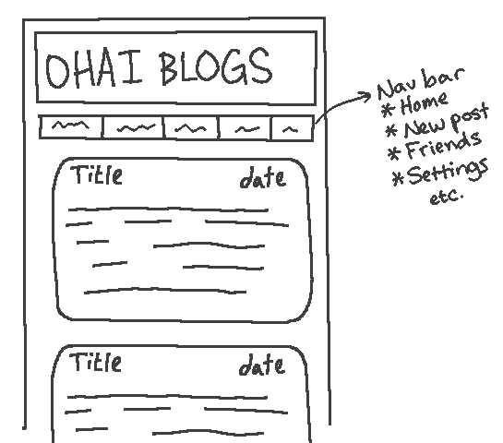
Sample design sketch

Slide 10
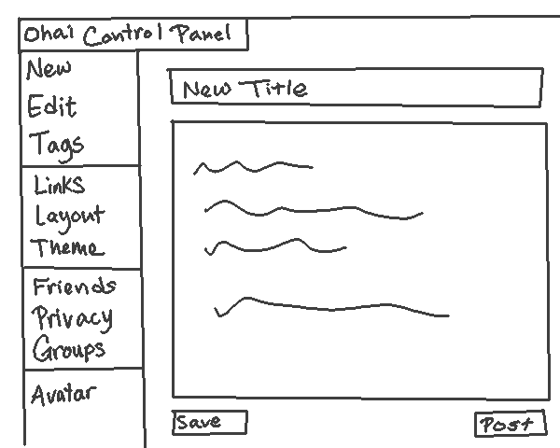
Sample design sketch

Slide 11
Misc
Also think about pages like “Privacy Policy” if you're ever collecting data from the user.
Look at other webpages – what do they have in their footers? About? Help & Support? Contact Us? Features? Social Media Links?

